Slide 1
Health Awareness and Nutrition
Department of Clinical Nutrition and Dietetics College of Health Sciences
Lecture 1:Introduction: Health and Nutrition

Slide 2
Definition of Health :
A state of complete physical, mental and social wellbeing and not merely an absence of disease or infirmity (WHO, 1948)
It is the general condition of a person's body, mind and spirit
It does not only mean to be free from illness, injury or pain

Slide 3
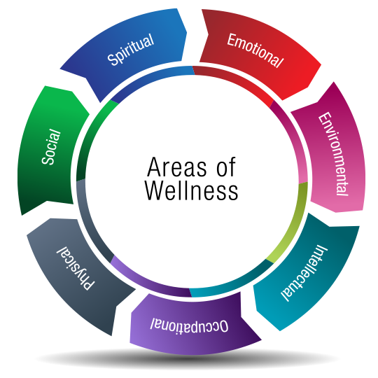
Dimensions of Health
The seven dimensions of wellness are physical, social, emotional, spiritual, environmental, occupational, and intellectual.
Often, one dimension may be more prevalent than the other, but ignorance of any factor may have an adverse effect on overall health.

Slide 4


Determinants of Health
Factors affecting our health and wellbeing:
Age, sex and Individual Physical Makeup
Individual Lifestyle Factors
Social and Community Networks
Living and Working Conditions
Unemployment
Water and Sanitation
Health Care Services
Housing
Work Environment
Education
Agriculture and Food Production

Slide 5
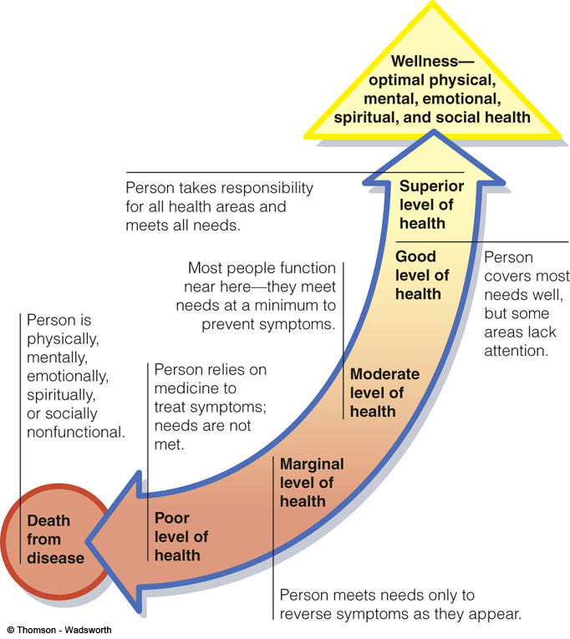
The Health Line
Person’s health can fall anywhere along a continuum, from maximum wellness to total failure to function (death)
Wellness
All of the characteristics that make a person strong, confident and able to function well with family, friends and others
Nutrition and Diet Therapy (7th Edition)

Slide 6
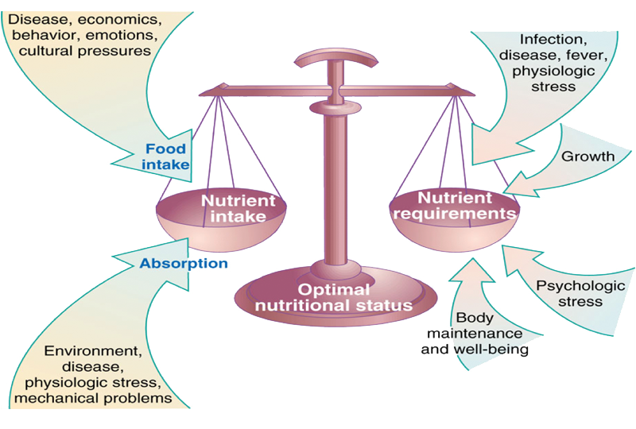
Nutrition and Health

Slide 7

Nutrition and Health
Nutrition is a critical part of health and development.
Better nutrition is related to improved infant, child and maternal health, stronger immune systems, safer pregnancy and childbirth, lower risk of non-communicable diseases (such as diabetes and cardiovascular disease), and longevity.

Slide 8
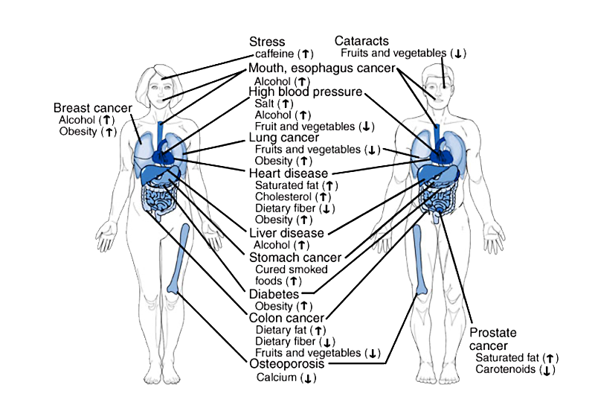
Health Problems Associated with Poor Dietary Habits

Slide 9
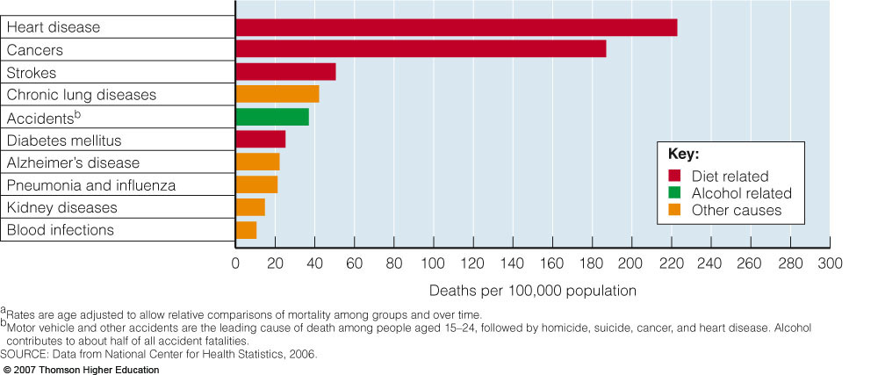
Nutrition and Health: Global Perspective

Slide 10
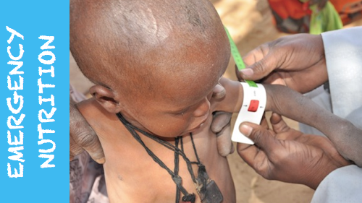

Interrelationship: Health & Nutrition
Balanced diet Optimum Nutrition Good Health
Imbalanced diet Malnutrition Poor Health
Under Nutrition
Over Nutrition
Deficiencies
Imbalance
Overweight & Obesity
Nutrient Excess

Slide 11
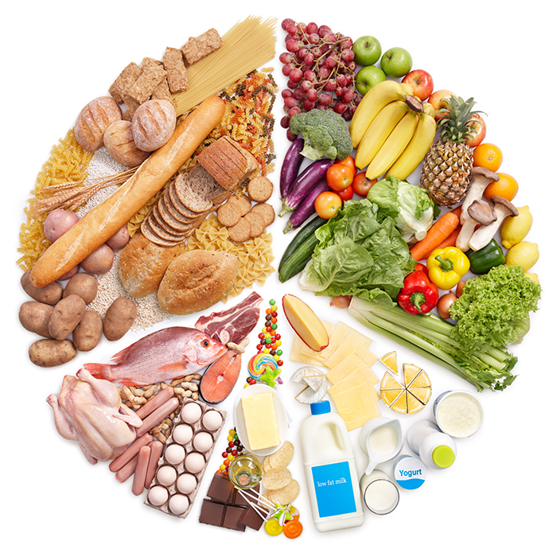
Interrelationship: Health & Nutrition
Balanced diet: A diet that contains all the nutrients in the right amounts and proportions to meet the nutritional requirements and enables growth and development to promote good health
Imbalanced diet: A diet that contains one or more nutrients in excess or deficient amounts to what is required by the body

Slide 12
Nutritional Status
Nutritional status: The state of nutrition in the body that is determined by the intake and utilization of nutrients
Optimum nutritional status: The state of nutrition in the body maintained by adequate intake and utilization of nutrients leading to good health

Slide 13

Factors Affecting Your Health
1. Diet
Imbalanced diets that are high in Fat, Sugar, Sodium, and Alcohol promote Chronic diseases such as, cancer, heart disease, osteoporosis, diabetes, & obesity.

Slide 14

Factors Affecting Your Health
2. Exercise
Promotes health by positively influencing body weight/composition, metabolism, bone density, cognitive function, blood pressure, blood cholesterol, and the cardiovascular system.
Strive for 30 minutes each day

Slide 15
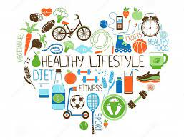
Factors Affecting Your Health
3. Other Factors
Smoking is a leading contributor to death
Habits (lack of sleep, alcohol & drug use)
Stress
Genetics

Slide 16
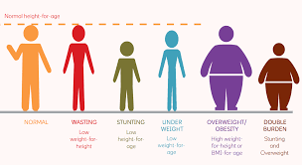
Malnutrition
Malnutrition refers to deficiencies, excesses, or imbalances in a person’s intake of energy and/or nutrients.
The term malnutrition addresses 3 broad groups of conditions:
1-Undernutrition
2-micronutrient-related malnutrition
3-Over nutrition(Excesses)

Slide 17
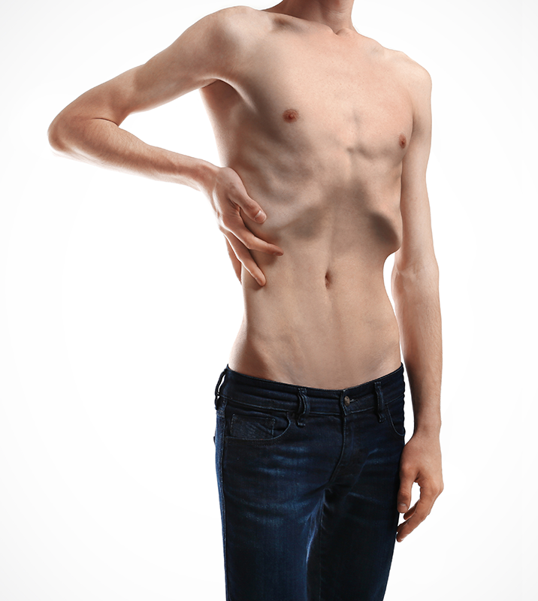
Malnutrition
Undernutrition: Inadequate state of nutrition resulting from lack of food intake or failure to absorb or utilize nutrients in the body
It is the outcome of insufficient food intake and repeated infectious diseases leading to poor absorption.

Slide 18
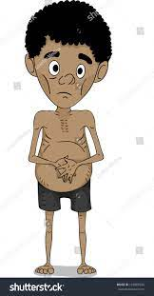
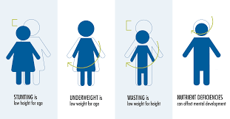
Malnutrition
Undernutrition: which includes
wasting (low weight-for-height),
stunting (low height-for-age) and
underweight (low weight-for-age)

Slide 19

Malnutrition
Micronutrient-related malnutrition: which includes micronutrient deficiencies (a lack of important vitamins and minerals)

Slide 20
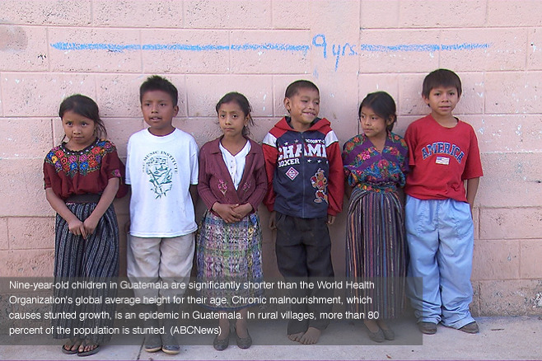
Types of Malnutrition
Undernutrition:

Slide 21

Malnutrition
Over nutrition(Excesses): overweight, obesity and diet-related noncommunicable diseases (such as heart disease, stroke, diabetes and some cancers).

Slide 22
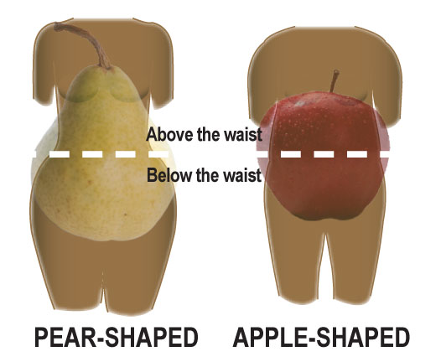

Types of Malnutrition
Overnutrition:
An imbalanced nutritional status resulted from excessive intake of nutrients
Generally, over nutrition generates an energy imbalance between food consumption and energy expenditure leading to disorders such as OBESITY

Slide 23
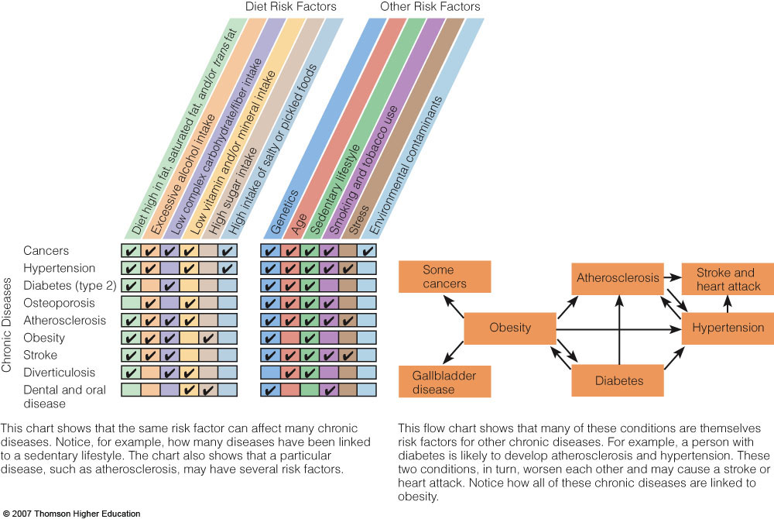
Nutrition and Health: Global Perspective

Slide 24

Assessment of Nutrition Status
ABCD Approach
A: Anthropometry: physical measurements and body composition, e.g. Height, weight, skin/fat fold thickness & circumferences
B: Biochemical tests: laboratory tests of blood, urine, stools, tissues
C: Clinical examination: physical signs and symptoms of nutritional deficiencies and excess
D: Dietary intake: dietary intake patterns, specific foods consumed, estimated nutrient intakes

Slide 25
